Slide 1
Study Unit 4 Data Management

Slide 2
Import Data

Slide 3
pandas Package
“pandas” is the most common package for data management in Python.
First, installing pandas using pip, then import pandas in our program:
import pandas as pd
Notes:
Now, we will discuss in detail how Python can be used for data management and data analytics.
The most common package for data management in Python is “pandas”. After installing pandas using pip, we can import it in our program.
Here, we use the alias pd to refer to the package pandas in our programs.

Slide 4
Import Data
We need Python compatible datasets to work with pandas.
Load a dataset in Python and open it in the format of pandas.
Convert .csv data files to pandas DataFrame by the read_csv() function.
read_csv() is a reader to convert specific format of data files into pandas DataFrame.
pandas also provides readers to import data files from other sources such as Excel, SPSS, Stata, etc.
DataFrame_name = pd.read_csv("csv_file_name.csv")
Notes:
To start working with pandas, we need to have Python compatible datasets.
Data circulating in organisations or on the internet are mostly saved as text files or worksheets.
Text editors, spreadsheets, and data management apps are popular tools for opening and working with them.
Pandas actually provides the same possibilities. The first step here is to load a dataset in the Python environment and open it in the format of pandas.
Suppose we have a dataset from an external source saved as a .csv text file, we can import it by the read_csv() function.
The content stored in the csv file will be assigned to the pandas dataset object, or DataFrame.
The function read_csv() is called a reader since it reads in specific format of data files and converts them into pandas DataFrame.
Same as functions in NumPy or matplotlib, the read_csv() function has more arguments than we list out here.
We can adjust the execution of the reader to the specifications of the .csv file with these arguments.
For instance, we can specify the character string of the delimiter, the row number in which header is stored, the path of the .csv file, etc.

Slide 5
pandas Readers
Reader | Format Type | Data Description
read_csv() | text | CSV
read_html() | text | HTML
read_clipboard() | text | Local clipboard
read_excel() | binary | MS Excel
read_stata() | binary | Stata
read_sas() | binary | SAS
read_spss() | binary | SPSS
read_pickle() | binary | Python Pickle Format
read_sql() | SQL | SQL
read_gbq() | SQL | Google BigQuery
Notes:
Here is a list of some pandas readers.

Slide 6
Display pandas DataFrames
We can use the print() function to display the whole DataFrame.
Alternatively, display() function achieves the same.
Another possibility is to print the DataFrames without any function.
Use the .head() method to display the first five rows of a DataFrame.
print(DataFrame_name)
display(DataFrame_name)
DataFrame_name
DataFrame_name.head()
Notes:
We can use the conventional print() function to display the whole DataFrame after import.
Nevertheless, this can be quite frustrating if the dataset contains many rows and columns, and the output does not fit to the window properly.
Another way to print the whole DataFrame is to use the display() function or omit the function completely and simply execute a syntax with only the name of the DataFrame.

Slide 7
Activity
Car sales program:
Carry out the following tasks in JupyterLab:
Read in the data file “car_model.csv” into Python as a pandas DataFrame. The data file contains 4 variables: Year, Make, Model, and Category.
Print the DataFrame and check on its dimension.

Slide 8
Discussion
What are the main differences between a dataset (or pandas DataFrames) and an array (or NumPy array)?
How different are the outputs of a DataFrame resulting from the different printing functions in Python? Which one is most/least preferrable when using JupyterLab as our programming environment?

Slide 9
Data Selection

Slide 10
Select Columns by Variables
Create a list of variable names to select specific columns of a DataFrame.
The variable names must be put within a pair of quotation marks.
To access one column, put the variable name as string inside the index operator directly.
DataFrame_name[["var_name1", "var_name2", …]]
Notes:
Same as Python lists or NumPy arrays, we can access a pandas DataFrame by using the index operator []. Here, we will introduce three ways to subset rows, columns, or elements of a DataFrame.
To select specific columns, which represent the variables of a dataset, we can create a list with the variable names (or labels) to be selected and then put it in the index operator.
Note that the variable names must be put within a pair of quotation marks since they are treated as strings in this case. If we simply want to access one column, we can omit the creation of the list and put the variable name as string inside the index operator directly.

Slide 11
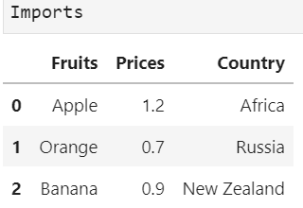
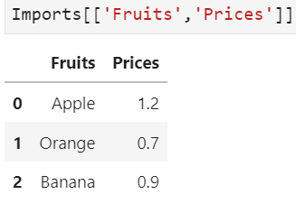
Example of column selection
Suppose we have a dataset on fruits, prices, and country of origin
imported as Pandas dataframe and named as Imports
To get the fruits and their prices, we use Imports[[‘Fruits’, ‘Prices’]]

Slide 12
Select Rows by Positions
We cannot refer to natural “observation names” to selecting rows.
pandas provides a row index to every row.
It starts with 0 and ends with the number of rows minus one.
Rows can be queried by the numeric index position using the DataFrame attribute iloc.
The indices must be integers, but they do not need to be consecutive.
If we select multiple rows, the indices must be put in a list first.
If we select one row, the index can be put in the index operator directly.
DataFrame_name.iloc[start:end]
Notes:
Accessing rows requires different techniques than accessing columns. While we can use the labels of the columns, or variable names, to select the columns we want, there are usually no natural “observation names” that we can refer to when selecting rows from a DataFrame. However, we saw that a row index is provided at the beginning of every row by pandas. It starts with 0 and ends with the number of rows in the DataFrame minus one. As a result, rows can be queried by the numeric index position, starting at 0, using the DataFrame attribute iloc.
The indices in the index operator do not need to be consecutive integers. It can be any integers within the range 0 and number of rows in the DataFrame - 1. But these integers must be put in a list first if there are more than one of them. If we want to select a single row instead, we can simply put one index in the index operator.

Slide 13
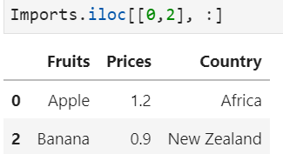
Example of row selection
First row and third row of imports, keep all columns
[0, 2] indicates the first and third rows of Imports
The ‘ : ’ after the comma indicates all columns

Slide 14
Select Rows by Indices
Another way to select rows is to use row indices.
Create row index labels by the method .set_index().
This method converts the values of a variable to row index labels.
The rows can be queried by the row index labels using the .loc attribute.
Put row labels as strings in a list for selecting multiple rows.
To select rows of a single label, put the label in .loc directly.
DataFrame_name.set_index(key, inplace = True)
DataFrame_name.loc[["row_label1", "row_label2", …]]
Notes:
Before we can select rows based on their index labels, we need to create the index labels first by the method .set_index().
The parameter key can be either a single variable name, a single array of the same length as the calling DataFrame, or a list containing an arbitrary combination of variable names and arrays. The argument inplace controls whether the DataFrame should be modified in place or a new DataFrame should be created. If it is True, the changes will take place in the original DataFrame.
The DataFrame rows can be queried by the row index labels using the .loc attribute.
We can see that selecting rows from a DataFrame by the .loc attribute works in a very similar fashion as the column selection. The row labels must be indicated as strings and put in a list if we want to select more than one of them. If we just want to select rows of a single label, we can put the label in the .loc attribute directly.

Slide 15
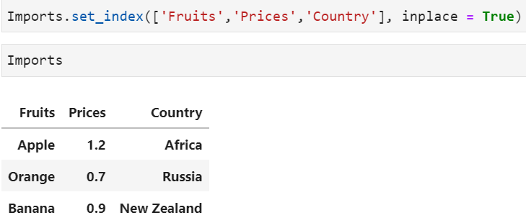
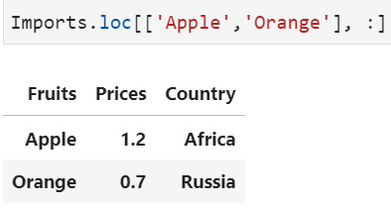
Example of using row indices
Use the variable names as a key for Imports
Then, we locate the ‘Apple’ and ‘Orange’ rows

Slide 16
Select Cells by Positions and Indices
Specify columns and rows by the .loc and/or .iloc attributes to select cells from a DataFrame.
Use one of the following syntaxes to select cells from a DataFrame:
DF_name.iloc[row_start:row_end, col_start:col_end]
DF_name.loc[["row_labels", "col_labels"]]
DF_name[["col_labels"]].iloc[row_start:row_end]
DF_name.loc[["row_labels"]].iloc[0:, col_start:col_end]
Notes:
To select elements in the DataFrame, we can specify both column and row labels in the .loc attribute, or the positions in the .iloc attribute, or a combination of both.
In the iloc attribute, use only the row and column indices for the cell selection.
In the loc attribute, we can select cells by referring to the corresponding row and column labels.
If we want to select the rows by index but the columns by labels, we can use the index operator and .iloc attribute together.
But if we want to select the columns by index but the rows by labels, we need to use both the .loc and .iloc attributes.
While putting the row labels in the .loc attribute, we need to be aware that the .iloc attribute requires both the row and column indices. Since we do not intend to select the rows by index, we can use the open-end index 0: here.

Slide 17
Select Cells by Boolean Masking
The elements of a Boolean mask array are either True or False.
Boolean mask array is overlaid on top of the queried DataFrame.
Elements aligned with True are selected.
More complex queries with several conditions are connected by bitwise logical operators.
If there are two conditions, two Boolean masks will be compared elementwise by the bitwise operator.
Each condition needs to be encased in parentheses.
DataFrame_name[Condition]
DataFrame_name[(Condition1) &/| (Condition2) &/| …]
Notes:
We have learned how to use Boolean mask to subset a NumPy array. Here, we will apply the same technique to select cells from a DataFrame. A Boolean mask is an array where each of the values is either True or False. The Boolean mask array is overlaid on top of the data structure that we're querying. And any element aligned with a True value will be selected, and any element aligned with a False value will not.
We can also create more complex queries by using bitwise logical operators to chain several conditions together.
The bitwise logical operators are similar to the logical operators. Instead of writing and/or, we use & (bitwise and), | (bitwise or), or ~ (bitwise not) to combine our conditions in the DataFrame queries. We can also add the bitwise not operator to the above syntax if we want to negate any condition.
We need the bitwise logical operators here because we are actually creating a Boolean mask for each condition within the index operator []. If there are two conditions, two Boolean masks will be compared elementwise by the bitwise operator. The result of this comparison is in turn a Boolean mask as well.
Remember that each Boolean mask needs to be encased in parentheses because of the order of operations.

Slide 18
Activity
Car sales program:
Carry out the following tasks in JupyterLab:
Select the column (variable) “Make” from the DataFrame.
Select all entries with the value “Audi” in the variable “Make” from the DataFrame.
Select the last 10 observations and only the variable “Year” from the DataFrame.

Slide 19
Discussion
Name situations where we would need to select data from a DataFrame.
How different are the syntaxes between row and column selections.

Slide 20
Merge DataFrames

Slide 21
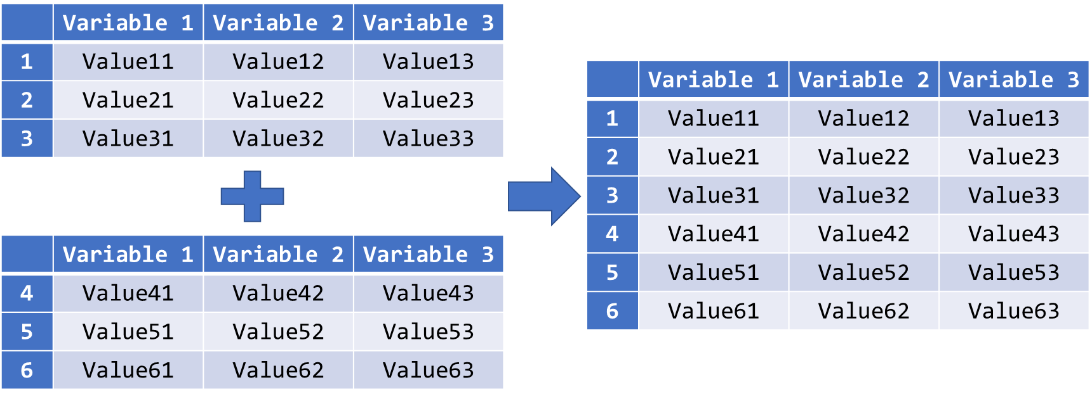
Append DataFrames by Rows
Concatenate two DataFrames with identical variables by rows:
Use the .append() method for such concatenation:
DataFrame_name.append(other = [OtherDataFrames])
Notes:
It often happens that multiple parties are actually collecting data for the same empirical study simultaneously.
Eventually, their collected data must be merged together for analyses.
Though the data could be collected at different locations or during different periods, they must consist of the same variables since the study is identical.
Merging these datasets means to append their rows below each other to become one dataset.
In Python, we can use the .append() method to merge two DataFrames with identical variables into one.
The parameter other is used for the specification of those DataFrames to be appended to DataFrame_name eventually.
If we only have one DataFrame to be assigned to the parameter other, we simply put its name without quotation marks behind other =.
In the case of specifying multiple DataFrames to the parameter other, we need to put their names in a list.

Slide 22
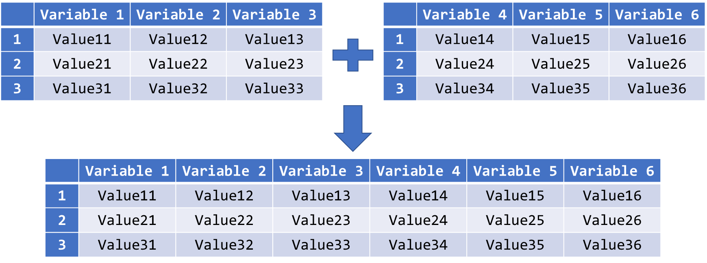
Merge DataFrames by Columns
Merge two DataFrames with identical observations by columns:
Notes:
The .append() method is applicable for merging two DataFrames with the same variables by rows. Nevertheless, there are other scenarios when merging multiple datasets in general.
Another rather uncomplicated scenario is that different variables are found across multiple DataFrames. But they contain the same observations.
For merging DataFrames by columns, they need to have identical keys, which are usually the row labels of the DataFrames. Python can use the row labels of both DataFrames to match identical observations and append their values of all the available variables in both DataFrames in the same row.

Slide 23
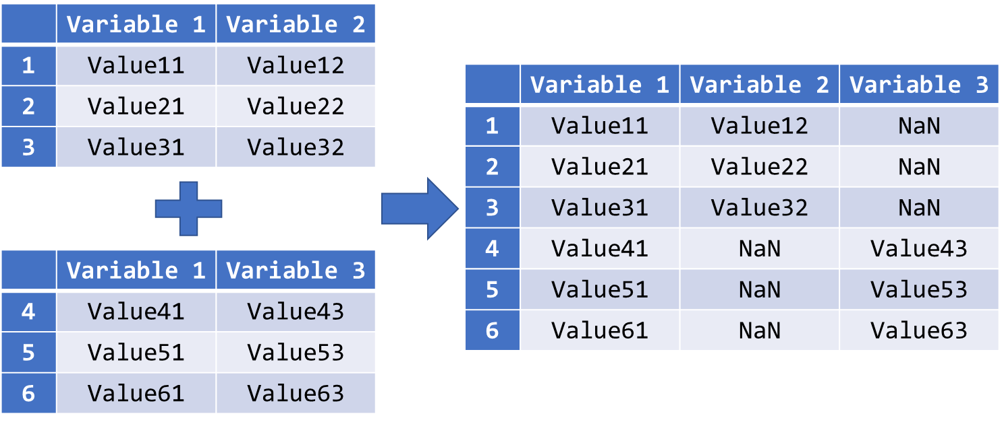
Outer Join DataFrames with Some Common Variables
Outer join two DataFrames with some common variables:
Notes:
A more complicated scenario is that we have multiple DataFrames with some common variables but completely different observations.
When merging DataFrames with some common variables, we may obtain two possible results: The output dataset contains either all available columns or only the common variables across all the DataFrames.
In the figure here, observation with row label 2 has only got values for Variable 1 and Variable 2. As a result, the value for Variable 3 of this row in the final DataFrame will be a missing value. This type of merging is called the outer join.

Slide 24
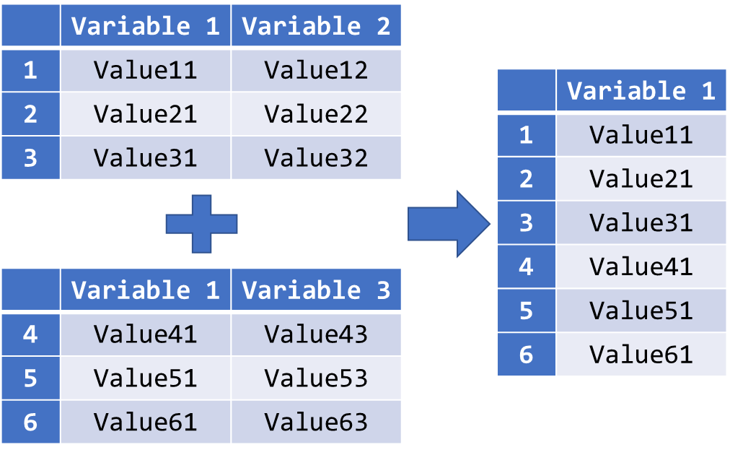
Inner Join DataFrames with Some Common Variables
Inner join two DataFrames with some common variables:
Notes:
The figure here illustrates the other possibility.
The final DataFrame only consists of Variable 1 since it is the only common variable in both DataFrames. This type of merging is called the inner join.

Slide 25
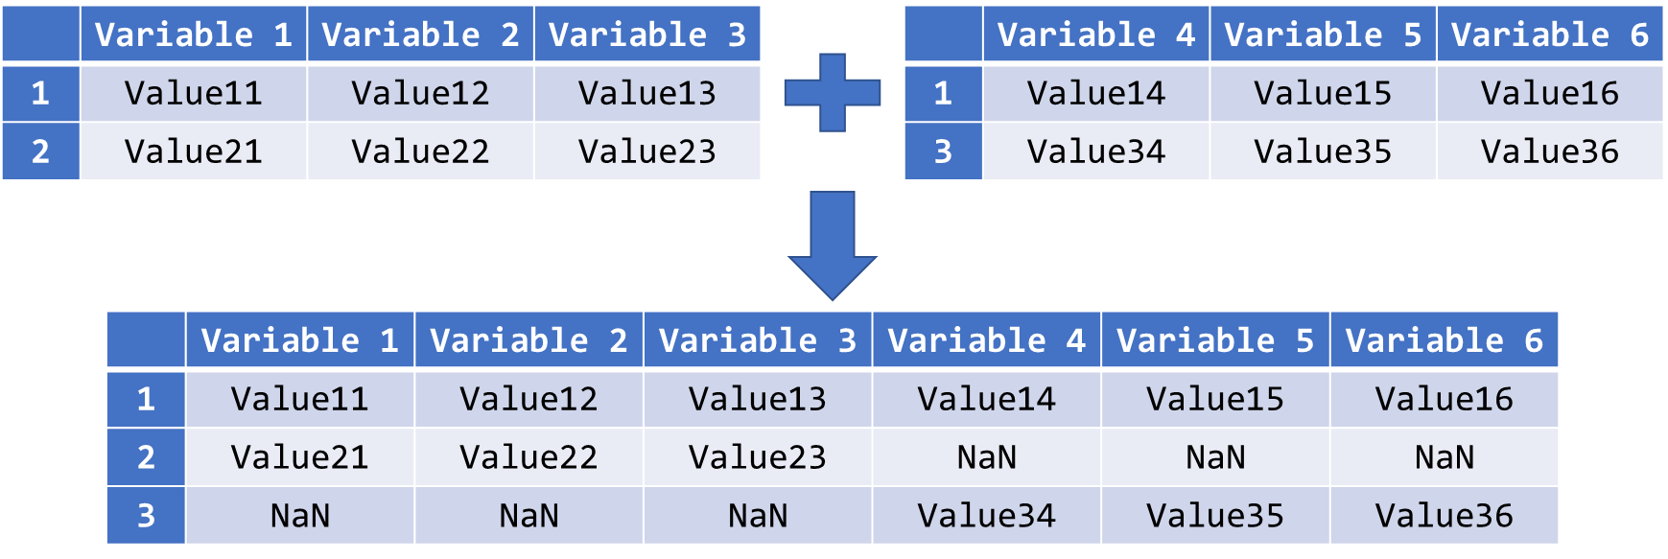
Outer Join DataFrames with Some Common Observations
Outer join two DataFrames with some common observations:
Notes:
Similarly, we may also get multiple DataFrames with some common observations but totally different variables.
We have two possible results here too: The output dataset contains either all available rows (outer join) or only the common rows across all the DataFrames (inner join).
Observation with row label 2 has only got values for Variable 1, Variable 2, and Variable 3. As a result, the values for Variable 4 to Variable 6 of this row in the final DataFrame are entirely missing values.

Slide 26
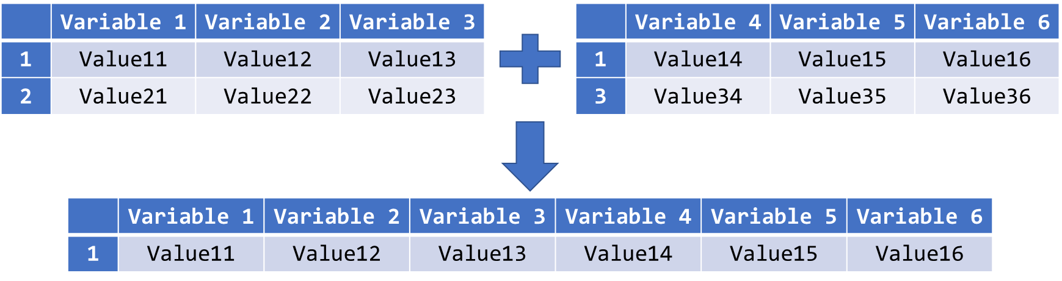
Inner Join DataFrames with Some Common Observations
Inner join two DataFrames with some common observations:
Notes:
If the DataFrames are merged by inner join, the final DataFrame will only consist of observation with ID = 1 since it is the only common observation in both DataFrames.

Slide 27
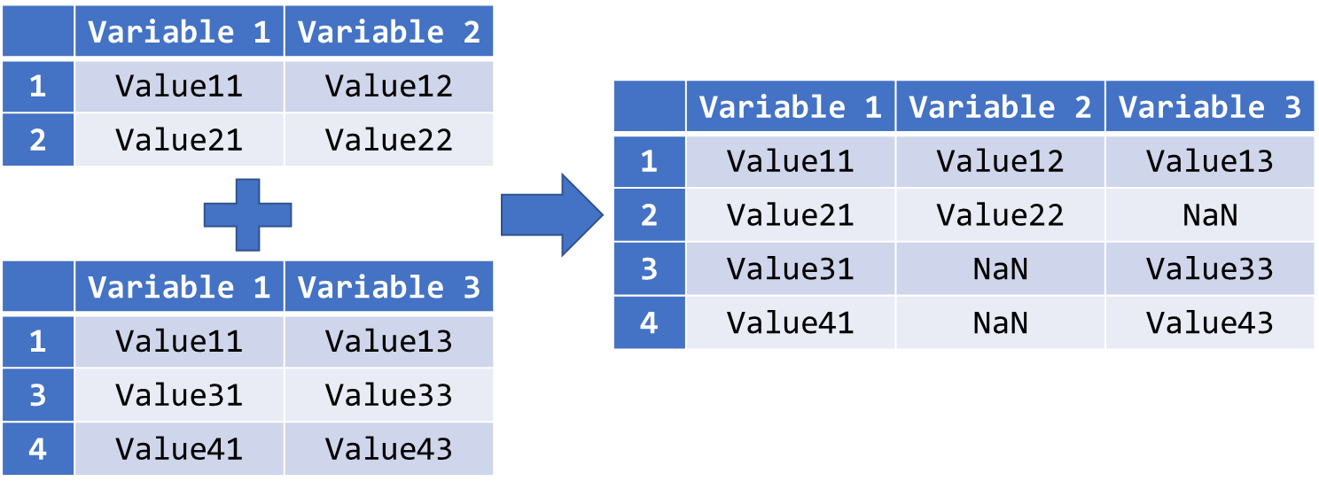
Outer Join DataFrames with Different Shapes
Outer join two DataFrames with different shapes:
Notes:
If two DataFrames have totally different shapes but some common variables and observations, and we merge them by outer join, the values of all available cells in either one of the original DataFrames will be taken over in the final DataFrame.
Cells that were originally unavailable in both DataFrames such as Value23 will become missing data.

Slide 28
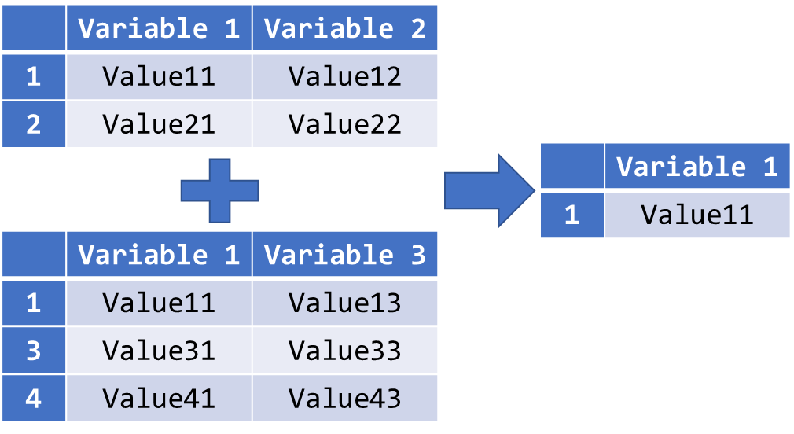
Inner Join DataFrames with Different Shapes
Inner join two DataFrames with different shapes:
Notes:
On the other hand, if we choose inner join to merge them, the result will be like the output dataset here.
Since Value11 is the only common cell in both DataFrames, it will also be the only cell in the output DataFrame.

Slide 29
Concatenate DataFrames
Use concat() to merge multiple DataFrames with different shapes.
The names of the DataFrames to be concatenated must be put in a list.
If axis = 0, the DataFrames will be concatenated below one another, and the concatenation will take place beside one another if axis = 1.
The join parameter controls the type of concatenation. The possible values here are "outer" and "inner", written as string.
finalDF_name = pd.concat(objs, axis, join)
Notes:
In Python, we can use the .concat() method to merge multiple DataFrames in all the described scenarios. It is a rather complex method, and we will only list out the most commonly used parameters in our syntax introduction.
The parameter objs is used for the specification of all the DataFrames to be concatenated. Be reminded that we need to put the DataFrame names in a list.
The parameter axis is the direction along which the concatenation should take place. If axis = 0, the DataFrames will be concatenated below one another, and the concatenation will take place beside one another if axis = 1. The default value here is 0.
With the join parameter, we can choose to carry out an outer join or inner join. The possible values here are "outer" and "inner", written as string. If we omit this parameter, “outer” will be considered.

Slide 30
Activity
Car sales program:
Carry out the following tasks in JupyterLab:
Read in the data file “car_price.csv” into Python. The data file contains 4 variables: Year, Make, Model, and Price (in USD).
Outer join the “car_model” and “car_price” data by their “year”, “make” and “model”.
Print the merged DataFrame and check on its dimension.
Delete duplicate columns from the DataFrame.

Slide 31
Discussion
Name situations in which we need to merge multiple DataFrames for analysis.
When is it more appropriate to use outer join instead of inner join and vice versa?

Slide 32
Missing Data and Outliers

Slide 33
Missing Data
In empirical studies, an observed value of a variable could be missing.
Reasons for missing data: defective measurement tools, withdrawal from the study, refusal of responses to sensitive questions, etc.
In Python, pandas indicates missing data with a special floating-point value, while NumPy uses NaN (“Not a Number”).
Missing data cannot be included in constructing models, forecasting, etc.
In pandas, missing values are ignored by the statistical functions.
Since the underlying sample sizes for each variable could vary in the computation due to missing data, the statistical estimation can be biased.
Notes:
In empirical studies, it often occurs that an observed value of a variable is missing.
There are many reasons for missing data: defective measurement tools, withdrawal from the study, refusal of responses to sensitive questions, etc.
In Python, there is the NoneType to indicate missing data. Different packages have different ways to display a missing value. For instance, Pandas uses a special floating- point value for missing values, and NumPy uses NaN which stands for “Not a Number”.
Missing data are not desirable for data analytics since they cannot be included in constructing models, forecasting, etc. Statistical estimation of parameters can be biased.
In pandas, when we use statistical functions on DataFrames, missing values are typically ignored by these functions.
As a result, the execution of the code will not be interrupted, but the computation of these functions will be based on different underlying sample size for each variable.

Slide 34
Identify Missing Data
pandas’ readers such as read_csv() have two parameters, na_filter and na_values, to convert certain strings to missing values directly.
If na_filter is True, pandas will convert all white spaces "" to NaN.
With na_values, we can declare certain strings from our DataFrame to be recognised as missing values.
The following strings are treated as missing values by default and do not require explicit declaration:
"", "#N/A", "#N/A N/A", "#NA", "-1.#IND", "-1.#QNAN", "-NaN", "-nan", "1.#IND", "1.#QNAN", "N/A", "NA", "NULL", "NaN", "n/a", "nan", "null"
DataFrame_name = pd.read_csv("csv_file_name.csv", na_values = "na_string", na_filter = True/False)
Notes:
Most of the time, we have to work with datasets provided from external sources, and missing values can be referred very differently.
The reasons of such discrepancies could be typing errors, or the varying habit of the data collectors when entering missing values, or the limitation of the software used for data entry, etc.
In pandas, readers such as the read_csv() function provides two parameters, na_filter and na_values, to convert certain strings to missing values directly while the data are being converted to pandas DataFrame.
The default value of the na_filter parameter is True. In this case, pandas will convert all white spaces "" to NaN. However, there could be situations where white space is an actual value of interest and not a missing value. The filter should then be turned off and the value is False.
With the parameter na_values, we can declare certain strings from our DataFrame to be recognised as missing values.
By default, strings like "", "#N/A", "#N/A N/A", "#NA", "-1.#IND", "-1.#QNAN", "-NaN", "-nan", "1.#IND", "1.#QNAN", "N/A", "NA", "NULL", "NaN", "n/a", "nan", "null" are treated as missing values and do not need to be specified explicitly with this parameter.

Slide 35
Locate Missing Data (I)
It is often not easy to locate the missing data in a dataset.
Count the NaNs in each row and each column to find the missing data.
Missing values exist in a variable if the number of NaNs is larger than zero.
Same approach is applicable to rows.
The method .isnull() checks every cell of a DataFrame and returns True if the cell contains a missing value and False otherwise.
The method .sum() adds up all the “True” (equal to 1) in each row or each column. It is equivalent to counting the missing values.
If axis = 0, the values in a column will be added up together. If axis = 1, it returns the sum of a row.
DataFrame_name.isnull().sum(axis = 0/1)
Notes:
We learned that the parameters in the read_csv() function can instruct Python to indicate missing values clearly with NaN in the DataFrame.
Though they will become uniquely identifiable, it is neither easy to locate their positions, nor to detect their existence, if the dataset contains a large number of rows and columns.
One way to find out their existence and positions is to count the NaNs in each row and each column.
If the number of NaNs in a column is larger than zero, we have then identified the variables in which missing values exist and including these variables may create biasedness in our analytics tasks.
And if the number of NaNs in a variable is large, we can also conclude that the variable may not contain sufficient data for reliable data analyses.
Equivalently, we can apply the same approach to rows. If the number of NaNs in a row is large, we know that missing values do not only exist for this observation, it may also not be carrying much information for our analyses.
The syntax here is in fact a Boolean masking. It contains two methods of the pandas package. The .isnull() method instructs Python to check every cell of the DataFrame and then return True if it is an NaN. Subsequently, Python should return the sum of each row or each column (of the Boolean Mask in this case). If the parameter axis is set to 0, the values in a column will be added up together. And if axis = 1, we will obtain the sum of the row instead. The default axis here is 0. Since True is usually represented by 1 and False by 0 when converting a Boolean variable to a numeric value, the sum of a row or a column with only Boolean values will therefore be the same as counting the occurrence of True in it.

Slide 36
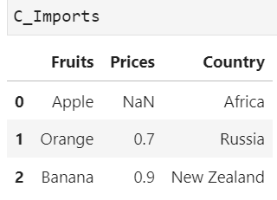
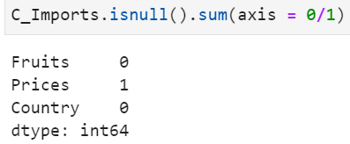
Example of Locating Missing Data (I)
Suppose our Imports dataset is corrupted, name it as C_Imports
Observe that the price of apple is missing, NaN
Now locate the missing data; there is 1 missing value in Prices

Slide 37
Locate Missing Data (II)
We can use .any() just to check whether missing data exist.
It returns True if any element in the attached array is True.
Retrieve the row/column indices with missing data by .index.
Counting the NaNs in columns means to check on the existence of missing values in each variable.
Counting the NaNs in rows means to identify observations with missing values in at least one of the variables.
The treatments of missing data are different in these two cases.
DataFrame_name.isnull().any(axis = 0/1)
object_name = DataFrame_name.isnull().any()
object_name[object_name == True].index
Notes:
If our intension is just to check the existence of missing values, we can use the .any() method instead. The .any() method will return True if at least one of the elements in the array returned by the .isnull() method is True.
We can retrieve the indices of the rows or columns with missing data by applying the .index method on the resulting object from the syntax above.
Counting the NaNs in columns has actually a different meaning than counting them in rows.
When we count the numbers of NaNs in columns, we are checking on the existence of missing values in each variable. If they exist, we may need different approaches to adjust the data for different types of variable. For instance, if they exist in a numeric variable, we can replace the missing values by zero or by the mean of the variables. And if a text variable contains missing data, we may add a response category such as “no reply” to it. We can also choose to neglect them if the variable is irrelevant for our analyses of the data.
By counting the NaNs in rows, however, we intend to identify those observations with missing values in at least one of the variables. Depending on the analyses and the importance of the observation, we can choose to delete the observation or to apply the appropriate data adjustments to the affected columns.

Slide 38
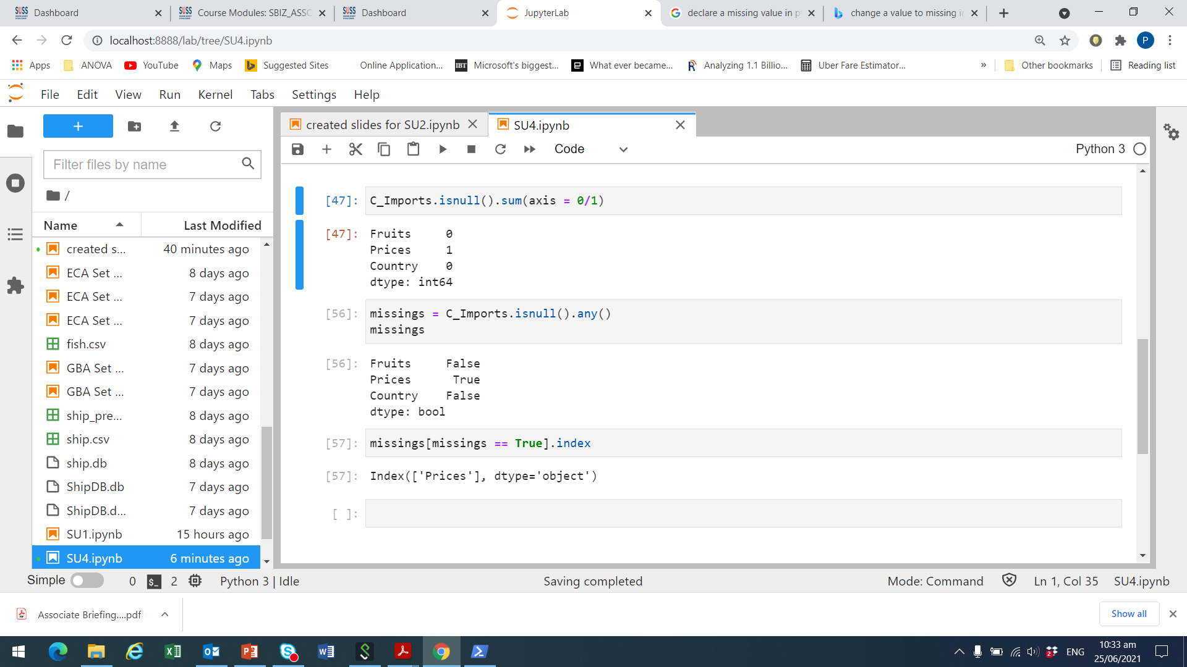
Example of Locating Missing Data (II)
Check for missing entries in C_Imports. Recall that price is missing
We see a ‘True’ for ‘Prices’
Now check the index which is missing
We see a ‘True’ for ‘Prices’

Slide 39
Delete Missing Data
The usual ways to treat missing data are:
delete the entire observations
replace them
ignore them
With .drop(), we specify the row indices with missing values that should be removed.
The .dropna() method combines the localisation and removal of rows or columns with missing data in a single function.
All missing values are treated and deleted by .dropna() equally.
DF_name.drop(axis = 0, index = [index1, index2, …])
DF_name.dropna(axis = 0, how = "any"/"all")
Notes:
After checking the existence of missing values in a DataFrame and locating them, we should decide on how to deal with them. Usually, we can consider deleting the entire observations, replacing them by other values, or simply ignoring them.
To delete an entire row with missing values from the DataFrame, we have two options: the .drop() and .dropna() methods.
With the .drop() method, we can delete an entire row or column by specifying the corresponding indices resulting from the localisation methods. The parameter axis indicates whether rows (0) or columns (1) should be dropped.
The .dropna() method combines the localisation and removal of rows or columns with missing data in a single function. Its usage is rather convenient since we can omit using the .isnull().any() and .index() methods before dropping the corresponding observations or variables.
The axis parameter in pandas functions or methods should not be a stranger to us anymore. With the how parameter, however, we can instruct Python to drop an observation with only missing values in all variables (all), or to drop an observation with at least one missing value in any variable (any).
The drawback of the .dropna() method is the equal treatment for all missing values throughout the entire dataset. Actually, there are many ways to adjust missing data for different types of variable. And depending on the observed values of other variables, we may also want to keep some of the rows with missing data while deleting others.

Slide 40
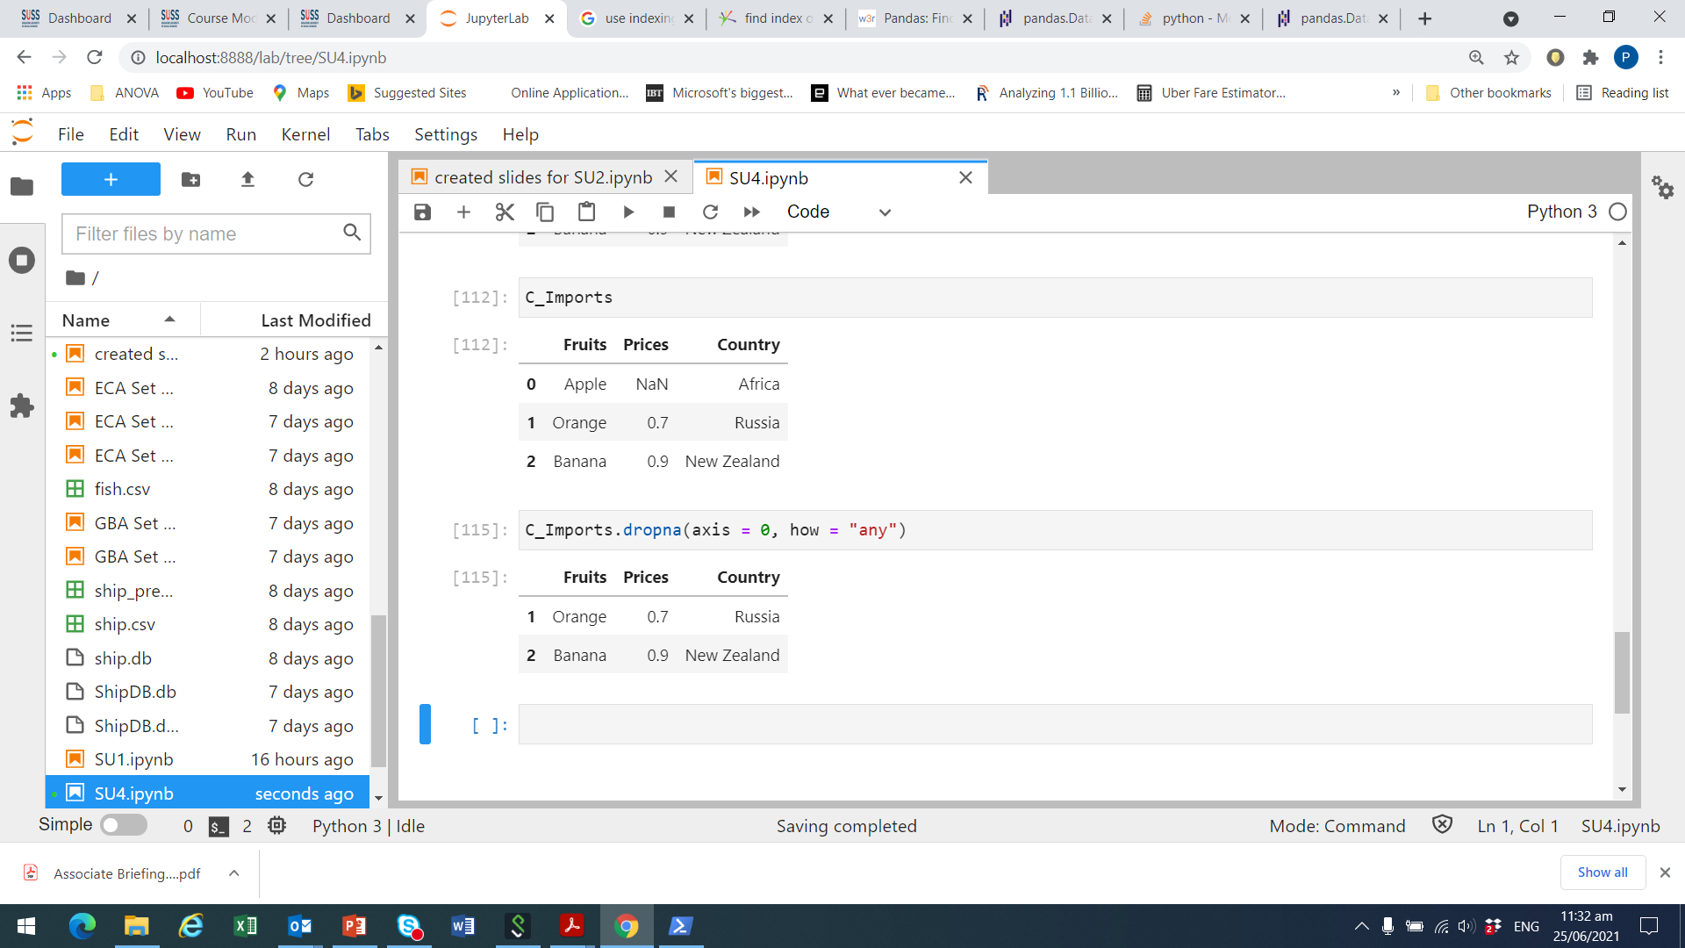
Example of Deleting Missing Data
Recall that Prices for Apple is missing in C_Imports.
We set how = “any” to drop the row for Apple with NaN for Prices.

Slide 41
Replace Missing Data
We can also replace missing values by a pre-defined value.
The most common values are 0 or the variable mean.
pandas facilitates replacement of missing values by .fillna().
The .fillna() method replaces all missing values with the value specified in the parameter.
We can also specify a column in the DataFrame where the missing values should be replaced by the .fillna() method.
DataFrame_name.fillna(value = repl_value)
DataFrame_name["column_label"].fillna(value = repl_value)
Notes:
Another possibility in dealing with missing values is to replace them by a pre-defined value.
The most common values used for such purpose are 0 or the variable mean. Some literatures also suggest more sophisticated approaches such as interpolation, extrapolation, or estimation.
In Python, the pandas package facilitates replacement of missing values by the .fillna() method.
Basically, if we apply the .fillna() method on the entire DataFrame, it will replace all missing values that Python could find with the value specified in the parameter.
But if we specify a column in the DataFrame and attach the .fillna() method to it, only the missing values found in the corresponding variable will be replaced. By doing this, we can treat missing data in various variable types differently.

Slide 42
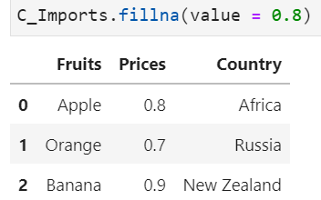
Example of Replacement
Recall that Prices for Apple is missing in C_Imports (i.e., NaN)
Replace NaN with the mean price of orange and banana
Mean is (.7 + .9) / 2 = .8

Slide 43
Outliers
Outliers can cause biasedness in the statistical estimation.
Draw histogram/boxplot or use interquartile range (IQR) to detect outliers in a variable.
Use .quantile() to determine the 1st and 3rd quartiles of a variable.
An observation y is considered as outliers if:
y < q1 – 1.5 * iqr or y > q3 + 1.5 * iqr
where q1 is the 1st quartile, q3 the third quartile and iqr = q3 – q1 is the interquartile range.
DataFrame_name["column_label"].quantile(q = quantile)
Notes:
Beside missing data, outliers are data that may cause biasedness in the estimation of statistical parameters and hence the goodness of fit of the models. Since biased estimates are undesirable, it is important to identify them and undertake appropriate adjustments before conducting any analysis.
Basically, we can use statistics such as the interquartile range (IQR) to detect the existence of outliers in a variable. Furthermore, visualisation like boxplots or histogram can also be useful to examine the distribution of the variables.
We learned how to use the sub-package matplotlib.pyplot to draw histogram in Python. The boxplot() function from the same sub-package facilitates the creation of the corresponding boxplot for outlier detection.
To compute the interquartile range, we can use the .quantile() method to determine the first and third quartiles of the variable.
With the parameter q, which should be a value between 0 and 1, we can define the quantile of the distribution that the .quantile() method should return to us. Once we have obtained the 0.25 and 0.75 quantiles of the target variable, the interquartile range can be computed by subtracting these two values from one another: iqr = q3 – q1. An observation y is considered as outliers if y < q1 – 1.5 * iqr or y > q3 + 1.5 * iqr.

Slide 44
Detect and Remove Outliers
Usually, outliers should be removed from the dataset.
In Python, it suffices to select observations with no outliers in the target variable.
The following syntax generates a subset of rows that do not fulfil the outlier condition.
DF[~((DF["Col"]<q1–1.5*iqr) | (DF["Col"]>q3+1.5*iqr))]
Notes:
The usual practice in dealing with outliers is to remove them from the dataset. In Python, it suffices to select those observations that do not contain outliers in the target variable. The syntax here generates a subset of rows that do not fulfil the outlier condition.
Note that DF represents the DataFrame_Name and Col is the column_label. The condition left from the bitwise or operator “|” selects all observations with values in “Col“ smaller than q1 - 1.5 * iqr whereas the condition right from it selects those observations larger than q3 + 1.5 * iqr. Nevertheless, this would be the combined condition to select all the outliers. To invert the selection, we need to put the bitwise not operator “~” before the entire condition, which must then be put in a pair of parentheses.

Slide 45
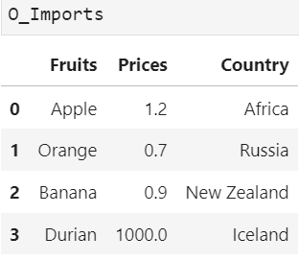
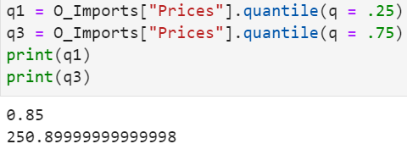
Example of Outliers (I)
Suppose our fruit imports dataset, ‘O_Imports’, now has 1 outlier
Durian with Prices of 1,000, from Ukraine; looks suspicious
Obtain the 1st quantile (q = .25) and 3rd quantile (q = .75)

Slide 46
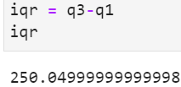
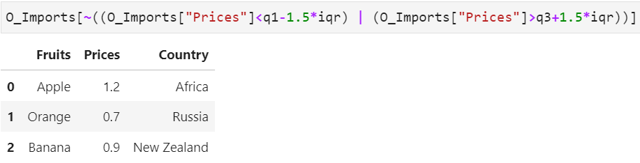
Example of Outliers (II)
Define interquartile range, iqr, as q3 – q1
Find the observations which are not outliers
Hence, Durians from Iceland with a Price of 1,000 is an outlier

Slide 47
Activity
Car sales program:
Carry out the following tasks in JupyterLab:
Remove all the rows with missing data in “price” from the merged DataFrame created in the previous chapter.
Detect car models that can be considered as outliers in terms of their selling price.
Discuss whether the models with extraordinarily high/low selling prices should be excluded from the DataFrame.

Slide 48
Discussion
How do missing data affect the estimation of model parameters by creating biases in it?
When is it recommended to study and treat missing value individually, when can we delete or replace them collectively?

Slide 49
Data Modification

Slide 50
Sort Data
Sometimes, we may want to sort the data according to the values of some variables for better understanding.
The method .sort_values() rearranges the order of the rows in a DataFrame.
A list of variable names based on which the DataFrame is sorted must be provided.
The sorting hierarchy among these variables drops with the increasing index in the list.
Data can be sorted in the ascending or descending order.
DataFrame_name.sort_values( by = [List_of_var_names], ascending)
Notes:
The order of the observations in a DataFrame is usually rather arbitrary and random. It can be a result of the sequence in which the data were collected or recorded, or in which they were merged.
Sometimes, we may want to sort the data according to values of some variables for better understanding.
For instance, we may want to sort an employee dataset by the rank of the employees in the organisation. In Python, the .sort_values() method from the pandas package helps us to rearrange the order of the rows in a DataFrame.
We can provide a list of variable names to the parameter by based on which the DataFrame will be sorted. They are the so called sorting keys.
The sorting hierarchy among these variables drops with the increasing index in the list.
If we set the parameter ascending to True, the values of the variables given as sorting keys will be sorted in the ascending order, and they will be sorted in the descending order if it is False.

Slide 51
Discretisation
Through discretisation, variables are easier to understand or becomes compatible to some specific analytics models such as decision trees.
Use the cut() function to discretise continuous variables.
Note that the data to be discretised should be converted to a one-dimensional NumPy array in the first place.
DataFrame_name["column"] = pd.cut(x = array, bins, right, labels, include_lowest, ordered)
Notes:
Sometimes, we need to bin continuous variables into discrete intervals.
Through discretisation, the variable could be easier to understand or becomes compatible to some specific analytics models such as decision trees.
In the past, we may need to write a lengthy program with various number of if-conditions for this purpose. In Python, we can use the cut() function from the pandas package to help us to discretise continuous variables.
Note that cut() is a function and not a method to be applied on the DataFrame directly. The object left from the equal sign can be any object including a new or existing column in the DataFrame that we are actually working with.
The data to be discretised should be converted to a one-dimensional NumPy array and then assigned to the parameter x.
With the parameter bins we can specify the number of equal-width bins for the discretisation of the array. But we can also define the bin edges here in a numeric tuple or numeric list instead.
The parameter right indicates whether the bins should include the rightmost edge or not. If it is False, the leftmost edge will be included instead. Note that one bin edge must be excluded in the discretisation in order not to have overlapping edges. Since the default value here is True, Python usually includes the highest value in the corresponding bin.
Therefore, the left edge of the first bin is not included as well by default. By assigning True to the parameter include_lowest we can instruct Python to include the left edge of the first bin.
We can also name the bins by assigning a list of strings to the parameter labels. And they can be ordered if we assign True, the default value here, to the parameter ordered.

Slide 52
Grouping Data
Analysing aggregated statistics of some variables are often of interest in data analytics.
Aggregated statistics are calculated based on grouped data.
A DataFrame can be grouped by one or more variables using the .groupby() method.
Attached to the .groupby() method can be any method for the calculation of the aggregated statistics.
DataFrame_name.groupby(by = [List_of_Labels]).anymethod()
Notes:
In data analytics, we often need to group the data by one or more variables and compute the aggregated statistics of some other variables for each group.
To group a DataFrame by some variables in Python, we can use the .groupby() function of the pandas package.
With the parameter by we can specify a list of column labels, or variable names, based on which the grouping should be conducted. These variables must be categorical so that the number of groups is finite and limited.
Attached to the .group() method can be any method that we would like to apply on the grouped data. These are usually NumPy methods and they are also applicable to pandas DataFrames.

Slide 53
Transformation
Sometimes, we may need to transform the values of a variable.
For instance, log-transformation can help to stabilise the variance of a variable.
In Python, there are various functions to transform variables.
For example, the log-transformation of a numeric variable can be carried out by the log() function from the NumPy package.
DF_name["new_var"] = np.log(DF_name["var_name"])
Notes:
In data analytics, we may need to transform the values of variables due to various reasons.
For instance, we can use the log-transformation to stabilise the variance of a variable. In Python, we can use various functions to transform variables.
The log-transformation of a numeric variable is rather straightforward. Since the log() function is not available in the pandas package, we need to take it from the NumPy package.
It is often useful not to replace the values in the original variable by transformed values since we may still need the original one for other purposes later.
As a result, we shall save the transformed values as a new variable in the same DataFrame.

Slide 54
Standardisation
Sometimes, variables included clustering could be measured at different scales and do not contribute equally to the analysis.
Hence, we need to standardise or normalise them.
The standardisation function can be found in the “scikit-learn” package.
To standardise a variable in the traditional way, we need to find the mean and the standard deviation of the variable first.
var_mean = np.mean(DF["var_name"])
var_std = np.std(DF["var_name"])
DF["std_var"] = (DF["var_name"] – var_mean) / var_std
Notes:
Sometimes we also need to standardise or normalise variables for analysis such as customer segmentation when they are measured at different scales and do not contribute equally to the analysis.
In Python, the standardisation function can be found in the “scikit-learn” and not the pandas package.
Here, we will use the most traditional way to standardise a variable by finding its mean and standard deviation first, and the transformation will be conducted by a formula as given here.
We can certainly write all the three lines into a single one without assigning the variable mean and variable standard deviation to different variables first. The advantage of splitting such a long syntax into three short ones is the readability of the code and convenience in debugging.

Slide 55
Normalisation
Normalisation is another transformation method to scale down a variable.
The values of a normalised variable can only be in the interval [0, 1].
The normalisation function can also be found in the “scikit-learn” package.
To normalise a variable in the traditional, we need to find the minimum and maximum of the variable first.
var_min = np.min(DF["var_name"])
var_max = np.max(DF["var_name"])
DF["norm_var"] = (DF["var_name"] – var_min) / (var_max – var_min)
Notes:
Normalisation is another transformation method to scale down a variable.
While there are no theoretical upper and lower bounds for standardised variables, the values of a normalised variable can only be in the interval [0, 1].
Same as the standardisation function, the normalisation function in Python can also be found in the “scikit-learn” package and not the pandas package.
As a result, we also use the most traditional way to normalise a variable here.
Same as the syntax for standardisation, we need to find the minimum and maximum of the target variable first and then transform the variable by a formula as shown here.

Slide 56
Activity
Car sales program:
Carry out the following tasks in JupyterLab:
Sort the data by “make”, “model” and “year” in the ascending order entirely.
Since the prices stored in the “price” variable are in US dollars, write a program to convert it into SGD. Store the resulting data as a new variable in the same DataFrame.
Calculate the mean price (in SGD) of each car brand.

Slide 57
Discussion
What happens to the bin edges in the discretisation process using the cut() function?
When is log-transformation/normalisation/standardisation necessary? What is the main difference between normalisation and standardization?

